Slide 1



ECE 3455: Electronics
Formal Reports Lecture
Dr. Dave Shattuck
Associate Professor, ECE Dept.
Shattuck@uh.edu
(713) 743-4422
Office: W326-D3

Slide 2

Formal Reports
The purpose of this lecture is to assist you in the preparation of your formal report this semester.
The purpose of the formal report is to give you some practice in technical writing, to an established format.

Slide 3
Formal Reports
The premise here is the following: Reading technical material is difficult. We need to make this job as easy as possible for the reader.

Slide 4
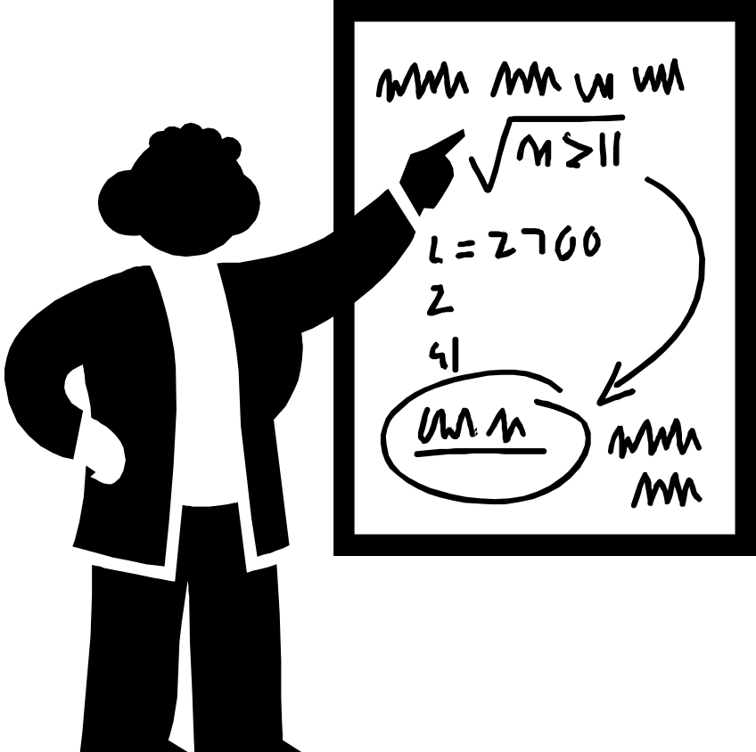
Formal Reports
We need to make reading as easy as possible for the reader. Therefore, our primary goal is clarity.

Slide 5
Formal Report Format Document
Use the current version of the formal report format document. The current version is
FormalFormat_rev28jun99.doc ,
and it is available on the network. A sample formal is also available on the network. It is not perfect, but it is a useful guide for formatting.

Slide 6
The Check Sheet
The checksheet that I use is also on the network. The current version is
CHKSHTV4.DOC
You do not need to reproduce this. However, you may wish to get a copy of it, and use it as you write. I compiled this list, since these things happened very often, and I got tired of writing these sentences. Therefore, it is a useful list of common errors.

Slide 7
Sections of the Formal Report: The Title Page
  The first page should include the title of your paper and other relevant information: date, course name, ….
  Leave your name off this. We want to read your paper without knowing who you are.

Slide 8
Abstract
The abstract should be a short version of your entire paper. The abstract must include the most important aspects of all parts of your paper; it is not simply an introduction.
Include quantitative information in your abstract. Report conclusions including numerical results, percentages, or whatever quantitative information is appropriate.
Make the Abstract a single paragraph and don’t include any references.

Slide 9
Introduction
Include…
  …an introduction (duh!) to what you are going to do.
  …a summary of what you did.
  …historical review (if any) and a summary of previous efforts (if you know of any).
Keep this short and sweet. Leave out the poetic musings.
Answer the question, “What is it all about?”

Slide 10
Theoretical Considerations or Design Approach
This “or” is an exclusive “or”. Do one or the other, not both.
Viewpoint: You are writing for someone “at your level”, i.e., someone who knows more or less what you know, but who has not done this particular project. Include enough theoretical development so that such a person can understand what you are about to tell them.
Answer the question, “What is going on here?”

Slide 11
Experimental Procedure
Include enough information so that someone at your level could reproduce the experiment/project if he or she wanted to. This is an important part of engineering communications.
Tell us what you did. This will have to be in the past tense, since it was completed before you started writing.
Answer the question, “What did you do?”

Slide 12
Results
State concisely and without embellishment what happened. Provide an explanation for everything, even if it seems trivial. Do not simply show tables or charts. Show these tables, charts, and plots, and explain what they mean.
Answer the question, “What happened?”

Slide 13
Discussion
How did your results compare with what you expected, and with what other people have observed previously (if you know this)?
Answer the question, “Why did it happen as it did?”

Slide 14
Conclusions
Summarize your results.
State concisely and clearly what you think is the most important thing to be learned from the experiment/project.

Slide 15
Appendix
Appendices are optional. However, if you include one (or more), do not simply staple hand-written sheets to the back of your paper. An appendix must be written out, just like the body of the report. Use the same kind of paper as the rest of your report. Use the same margins as the rest of your report. Include page numbers, as in the rest of your report.

Slide 16
Figures
All figures are numbered sequentially beginning with “1”, and have captions. The captions go below the figure.
All figures must be cited in the text (in other words, don’t include a figure that has not been introduced and discussed in the text).
Figures may be hand-drawn, although computer generation is considerably more impressive. If hand drawn, they must be in ink. Do not use pencil.

Slide 17
Tables
All tables are numbered sequentially beginning with “1”, and have titles. The titles go above the table.
All tables must be cited in the text (in other words, don’t include a table that has not been introduced and discussed in the text).

Slide 18
Equations
Do not be afraid to use equations. Use them when they will help communicate your intentions.
All equations must be numbered, and referenced, if appropriate.
Equations are part of a sentence, and must be punctuated appropriately. They do not stand alone.
Use an equation writer.

Slide 19
“Formal” Writing
Make sure your writing is “formal”. Avoid slang. Avoid the kind of language and sentence structure you would use with friends in the hallway or at a sporting event.

Slide 20
Examples of Informal Writing
“So let’s look at the next figure and see how we built this circuit.”
“We worked really hard but we just couldn’t get the thing to work the way we wanted.”
“Then we put a really big capacitor in parallel with the resistor.”
“We turned the thing on and there were all kinds of sparks and smoke! It was way cool!”

Slide 21
Proper Capitalization
Capitalize proper nouns and titles.
Capitalize abbreviations for units that are based on someone’s name.
Capitalize acronyms (in most cases).
Do not capitalize the names of elements or compounds, but do capitalize their abbreviations.

Slide 22
Capitalization Examples
12 V, 3.2 mA, 6 MW
50 km, 300 s
1.1 eV
Si, GaAs
silicon, gallium arsenide
resistance measurement
“This work was supported by NSF.”
“We hired Associate Professor Al Einstein.”
“Al Einstein is an associate professor.”

Slide 23
…but English is not my native language!
…then get someone to proofread your paper.

Slide 24
Don’t Forget…
…page numbers
…proper margins
…proper spacing
…to review the Formal Report Format to make sure all of this stuff is correct.

Slide 25
Problems with Formal Reports
Each reference must have a page number or other mechanism for pointing the reader to the exact location of the source. Many students simply referenced a book, without a specific page number being included, or a range of pages was indicated. This is not sufficient. It is necessary to state clearly the exact location in the source that you have used. Any clear reference method is acceptable. [5, p.7]

Slide 26
Problems with Formal Reports
Several people used figures, or sentences, from handouts, from the text, from my lecture notes, or from another student’s report, without a reference being present. This is plagiarism.

Slide 27
Problems with Formal Reports
(Continued) If you wish to take a figure from any source, and include it in your report, you must indicate clearly that you have done this. The easiest way to do this is to place a reference at the end of the caption, indicating the source.

Slide 28
Problems with Formal Reports
(Continued) I want you to draw/prepare your own figures, circuit schematics, tables, and everything else. This is part of the preparation of a report, and I want each of you to do it. However, if you do not, it just lowers your grade, as long as you reference it. The requirement that you not plagiarize is a major issue, and results in an academic honesty hearing.

Slide 29
Problems with Formal Reports
(Continued) If you wish to take a sentence, or a major sentence fragment, from any source, and include it in your report, you must indicate this clearly. This means placing that text inside quotation marks. Then, you place a reference at the end of the quote, indicating the source.
“Quoting is not required, nor even desirable, but if it is necessary, you must indicate that you have quoted.”[7, p.56]

Slide 30
Proper Referencing
Q: Do I have to reference class handouts on the lab?
A: YES!!! YES!!!
While it may appear that such handouts are “common knowledge” to your classmates, we will assume that your classmates have not done the experiment. They are specific technical documents that you did not generate, and must be referenced.

Slide 31
Proper Referencing
Q: Do I have to reference a thing if I didn’t quote it directly?
A: YES!!! YES!!!
You must reference specific information (as discussed above) whether you quote it directly or not.

Slide 32
Proper Referencing
Q: Do I have to reference something I got from the web?
A: YES!!! YES!!!
For example…
http://www.uoguelph.ca/~antoon/circ/circuits.htm (“Circuits for the Hobbyist”, Tony van Roon, Guelph, Ontario)

Slide 33
Problems with Formal Reports
(Continued) You must attach a signed Formal Report Submission Form to the front of your report. If it is not present, I will reject the report without reading it.

Slide 34
Problems with Formal Reports
Several students had no quantitative information in their abstract. This is not appropriate. Most technical reports should have some numerical results in the abstract. This rule is widely ignored, but this does not make it acceptable to perpetuate an inappropriate practice.

Slide 35
Problems with Formal Reports
(continued) Remember that the abstract is intended to be a short version of your entire paper. People who read your abstract, typically do not read the rest of your paper. The abstract must include the most important parts of all aspects of your paper.

Slide 36
Problems with Formal Reports
Someone should be able to read your report. Thus:
  Your results section must not be just data.
  All figures must be ‘referenced’ in the text.
  Your appendix must not be just data.
  Your equations need to be included in your sentences, and punctuated as if they were parts of your sentences.

Slide 37

Problems with Formal Reports
Somewhere, many students have developed the notion that longer papers are better papers. RONG! The truth is just the opposite! Shorter papers are better papers. Don’t work to make your paper longer. It won’t help. It may hurt.

Slide 38
Instructions
The following instructions are adapted from a memo sent by A. B. El-Kareh, an Associate Dean here, in 1980. I offer them for your consideration.
  No sentence fragments.
  Eschew obfuscation.
  Proofread carefully to see if you any words out.
  Avoid commas, that are not necessary.

Slide 39
Instructions
Instructions from A. B. El-Kareh:
  Avoid run-on sentences they are hard to read.
  Verbs has to agree with their subjects.
  Don’t use contractions in formal writing.

Slide 40
Instructions
Instructions from A. B. El-Kareh:
  Do not overuse exclamation points!!!
  And do not start a sentence with a conjunction.
  Do not use no double negatives.

Slide 41
Instructions
Instructions from A. B. El-Kareh:
  If you reread your work you will find on rereading that a great deal of repetition can be avoided by rereading and editing.
  Use the semicolon properly, always use it where it is appropriate; and never where it isn’t.

Slide 42
Instructions
Instructions from A. B. El-Kareh:
  Also avoid awkward or affected alliteration.
  Be consistent in your use of tense. If you start in one tense, you stayed in that tense.

Slide 43
Instructions
Instructions from A. B. El-Kareh:
  Work as hard as you can to find ways to reduce as much as possible the number of words, phrases, or sentences needed to convey your ideas, thoughts, and concepts, and by doing so you will make your paper be brief and easier to understand as a result.

Slide 44
Instructions
Instructions from A. B. El-Kareh:
  Reserve the apostrophe for it’s proper use and omit it when its not needed.
  Double space after periods .Single space after commas ,and do not put any spaces before either .
  Hyphenate between syllables and avo-
  id un-necessary hyphens.

Slide 45


Who cares about this stuff?
I do, obviously. But that is not really your question. Your question is, why should you care about this?
You should care about this because clear communication of ideas is crucial to being a successful engineer. You should care because employers regularly tell engineering educators everywhere that communications skills
is the most serious shortcoming in
graduating engineering students.

